Slide 1

An AI approach to Large Scale Medical Appointment Rescheduling using ASP
KR in digital healthcare
Stavros Kanias
University of Patras, Greece

Slide 2
Introduction
Medical appointments reamaining unclaimed after a cancelation have a significant cost in many aspects. ASP can help with that but further software integration steps are essential. Using Python, Clingo and SQL a solution to the problem was developed. Results seem promising.

Slide 3
What to expect
01
02
03
04
The problem
Technical constraints
Why fair and optimized rescheduling of medical appointments matters
Without the ability to provide an ASP solver with large scale data from a database no real-world solution can be developed
The AI solution
From concept to reality
Description and evaluation of the proposed ASP application
Implementing the proposed solution in a real-world healthcare system

Slide 4
01
The problem
It’s not that bad, right?

Slide 5
—MMWR 2020
“An estimated 41% of U.S. adults had delayed medical care including urgent or emergency care (12%).”

Slide 6
51.7% below 50k
26 days
$150 billion
Delayed treatments due to unavailable appointments mostly concern low-income households
Average waiting time for an appointment in the US for 2022
The monetary loss for the US healthcare system due to unclaimed medical appointments

Slide 7
An example
Conventional vs AI approach

Slide 8
The conventional approach
Maximize the individual benefit

Slide 9

Initial state
Timeslots
Appointment Schedule
Monday | Patient - Score
9-10 | Nikos – 90
 | Giorgos – 87
 | Kostas – 86
 | Monday | Tuesday | Wednesday | Thursday | Friday
9-10 | Nikos
10-11
11-12 |  |  |  | Ioannis
12-13
13-14 |  | Giorgos
14-15
15-16 |  |  |  |  | Kostas
16-17
Tuesday | Patient - Score
13-14 | Giorgos - 72
 | Ioannis - 60
 | Maria - 55
Thursday | Patient - Score
11-12 | Ioannis - 45
 | Maria - 40
Friday | Patient - Score
15-16 | Kostas - 71
 | Despoina - 70
$$Score=\frac{0.3}{preference} + 0.7∙priority$$
Community Benefit = 90 + 72 + 45 + 71 = 278

Slide 10
Initial state
Timeslots
Appointment Schedule
Δευτέρα | Ασθενής - Όφελος
9-10 | Nikos – 90
 | Giorgos – 87
 | Kostas – 86
 | Monday | Tuesday | Wednesday | Thursday | Friday
9-10 | Nikos
10-11
11-12 |  |  |  | Ioannis
12-13
13-14 |  | Giorgos
14-15
15-16 |  |  |  |  | Kostas
16-17
Tuesday | Patient - Score
13-14 | Giorgos - 72
 | Ioannis - 60
 | Maria - 55
Thursday | Patient - Score
11-12 | Ioannis - 45
 | Maria - 40
Friday | Patient - Score
15-16 | Kostas - 71
 | Despoina - 70
$$Score=\frac{0.3}{preference} + 0.7∙priority$$
Community Benefit = 90 + 72 + 45 + 71 = 278

Slide 11
Nikos cancels his appointment
Timeslots
Appointment Schedule
Monday | Patient - Score
9-10 | Nikos – 90
 | Giorgos – 87
 | Kostas – 86
 | Monday | Tuesday | Wednesday | Thursday | Friday
9-10 | Nikos
10-11
11-12 |  |  |  | Ioannis
12-13
13-14 |  | Giorgos
14-15
15-16 |  |  |  |  | Kostas
16-17
Tuesday | Patient - Score
13-14 | Giorgos - 72
 | Ioannis - 60
 | Maria - 55
Thursday | Patient - Score
11-12 | Ioannis - 45
 | Maria - 40
Friday | Patient - Score
15-16 | Kostas - 71
 | Despoina - 70
Community Benefit = ?

Slide 12
New timeslots become available for Giorgos and Ioannis
Timeslots
Appointment Schedule
Monday | Patient - Score
9-10 | Giorgos – 87
 | Kostas – 86
 | Monday | Tuesday | Wednesday | Thursday | Friday
9-10 | Giorgos
10-11
11-12 |  |  |  | ?
12-13
13-14 |  | Ioannis
14-15
15-16 |  |  |  |  | Kostas
16-17
Tuesday | Patient - Score
13-14 | Ioannis - 60
 | Maria - 55
Thursday | Patient - Score
11-12 | Ioannis - 45
 | Maria - 40
Friday | Patient - Score
15-16 | Kostas - 71
 | Despoina - 70
Community Benefit = ?

Slide 13
Now Maria can receive an appointment
Timeslots
Appointment Schedule
Monday | Patient - Score
9-10 | Giorgos – 87
 | Kostas – 86
 | Monday | Tuesday | Wednesday | Thursday | Friday
9-10 | Giorgos
10-11
11-12 |  |  |  | Maria
12-13
13-14 |  | Ioannis
14-15
15-16 |  |  |  |  | Kostas
16-17
Tuesday | Patient - Score
13-14 | Ioannis - 60
 | Maria - 55
Thursday | Patient - Score
11-12 | Maria - 40
Friday | Patient - Score
15-16 | Kostas - 71
 | Despoina - 70
Community Benefit = 87 + 60 + 40 + 71 = 258

Slide 14
The
AI
approach
Maximize the community benefit

Slide 15
The same initial state
Timeslots
Appointment Schedule
Monday | Patient - Score
9-10 | Nikos – 90
 | Giorgos – 87
 | Kostas – 86
 | Monday | Tuesday | Wednesday | Thursday | Friday
9-10 | Nikos
10-11
11-12 |  |  |  | Ioannis
12-13
13-14 |  | Giorgos
14-15
15-16 |  |  |  |  | Kostas
16-17
Tuesday | Patient - Score
13-14 | Giorgos - 72
 | Ioannis - 60
 | Maria - 55
Thursday | Patient - Score
11-12 | Ioannis - 45
 | Maria - 40
Friday | Patient - Score
15-16 | Kostas - 71
 | Despoina - 70
Common Benefit = 90 + 70 + 45 + 75 = 280

Slide 16
Again, Nikos cancels his appointment but …
Timeslots
Appointment Schedule
Monday | Patient - Score
9-10 | Nikos – 90
 | Giorgos – 87
 | Kostas – 86
 | Monday | Tuesday | Wednesday | Thursday | Friday
9-10 | Nikos
10-11
11-12 |  |  |  | Ioannis
12-13
13-14 |  | Giorgos
14-15
15-16 |  |  |  |  | Kostas
16-17
Tuesday | Patient - Score
13-14 | Giorgos - 72
 | Ioannis - 60
 | Maria - 55
Thursday | Patient - Score
11-12 | Ioannis - 45
 | Maria - 40
Friday | Patient - Score
11-12 | Kostas - 71
 | Despoina - 70
Common Benefit = ?

Slide 17
This time the system chooses Kostas
Timeslots
Appointment Schedule
Monday | Patient - Score
9-10 | Kostas – 86
 | Giorgos – 87
 | Monday | Tuesday | Wednesday | Thursday | Friday
9-10 | Kostas
10-11
11-12 |  |  |  | Ioannis
12-13
13-14 |  | Giorgos
14-15
15-16 |  |  |  |  | ?
16-17
Tuesday | Patient - Score
13-14 | Giorgos - 72
 | Ioannis - 60
 | Maria - 55
Thursday | Patient - Score
11-12 | Ioannis - 45
 | Maria - 40
Friday | Patient - Score
15-16 | Kostas - 71
 | Despoina - 70
Common Benefit = ?

Slide 18
And a greater community benefit is provided
Timeslots
Appointment Schedule
Monday | Patient - Score
9-10 | Kostas – 86
 | Giorgos – 87
 | Monday | Tuesday | Wednesday | Thursday | Friday
9-10 | Kostas
10-11
11-12 |  |  |  | Ioannis
12-13
13-14 |  | Giorgos
14-15
15-16 |  |  |  |  | Despoina
16-17
Tuesday | Patient - Score
13-14 | Giorgos - 72
 | Ioannis - 60
 | Maria - 55
Thursday | Patient - Score
11-12 | Ioannis - 45
 | Maria - 40
Friday | Patient - Score
15-16 | Despoina - 70
Common Benefit = 80 + 70 + 45 + 70 = 273 > 258

Slide 19
Solution requirements
A real-world digital solution to this problem should be characterized by the following features:
High performance (large sets of data in healthcare)
Integration with existing digital healthcare software
Fairness and optimality
Pleasant user experience
Scalability
Ability to express complex scenarios
Can ASP help?

Slide 20
02
Technical constraints
Yes, but first…

Slide 21
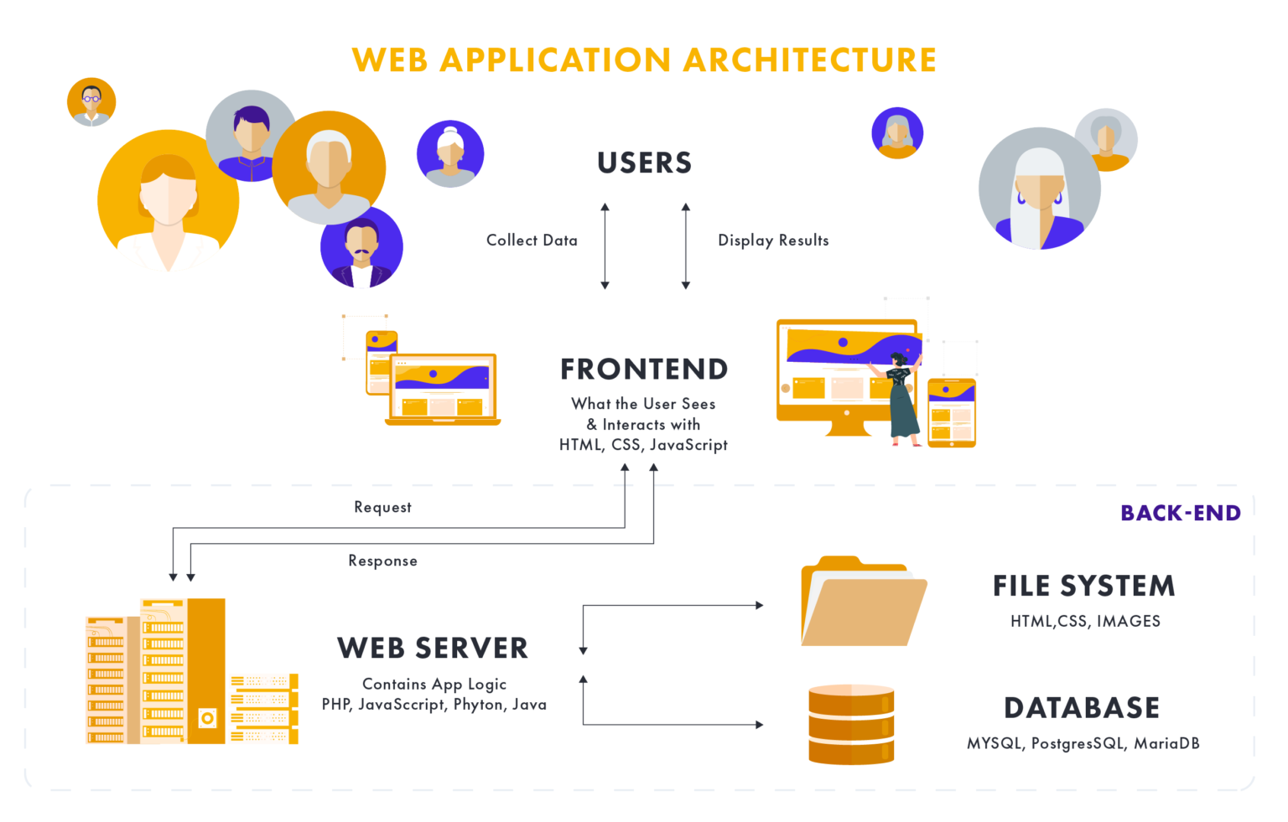



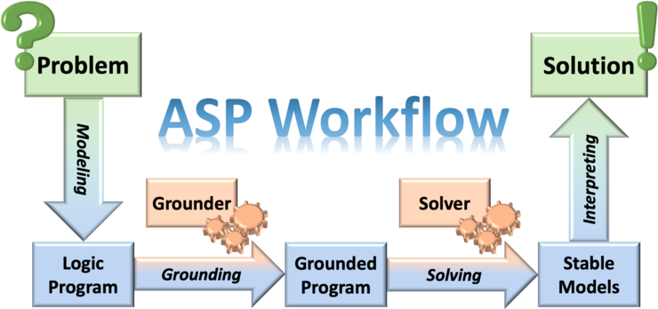
ASP must be integrated with standard software

Slide 22
The three points of data flow
(un)scheduled data
Knowledge Base
(re)scheduled data
Output predicates
PostgreSQL DB
Python
Clingo Solver
By being the software component where data is stored, a solid database is indeed the base of every modern application
The Python programming language with its clorm, clingo and psycopg2 modules can be used to enable the communication between the batabase and the ASP solver
The clingo solver created by Potassco offers outstanding performance and rule formulation capabilities

Slide 23
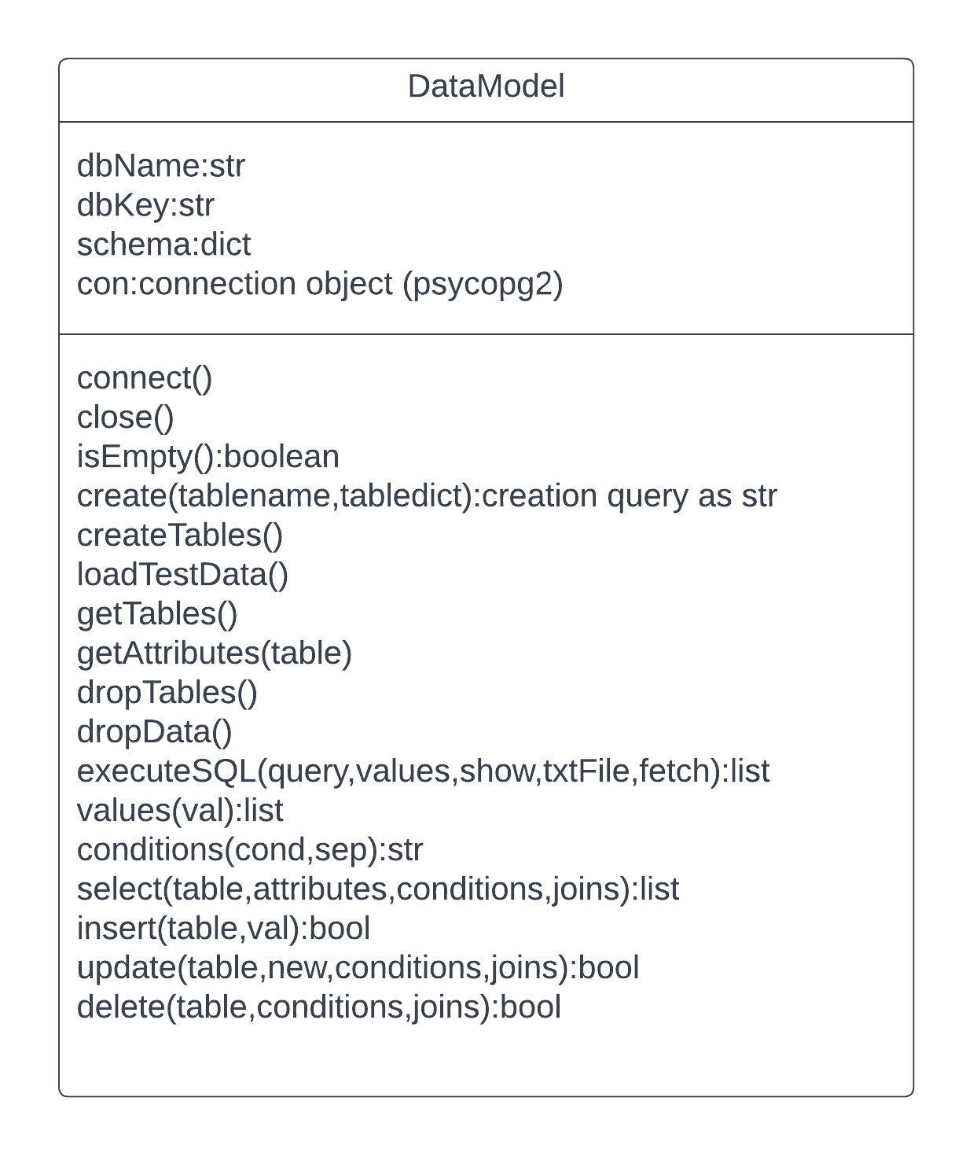
Python and postgreSQL
psycopg2

Slide 24
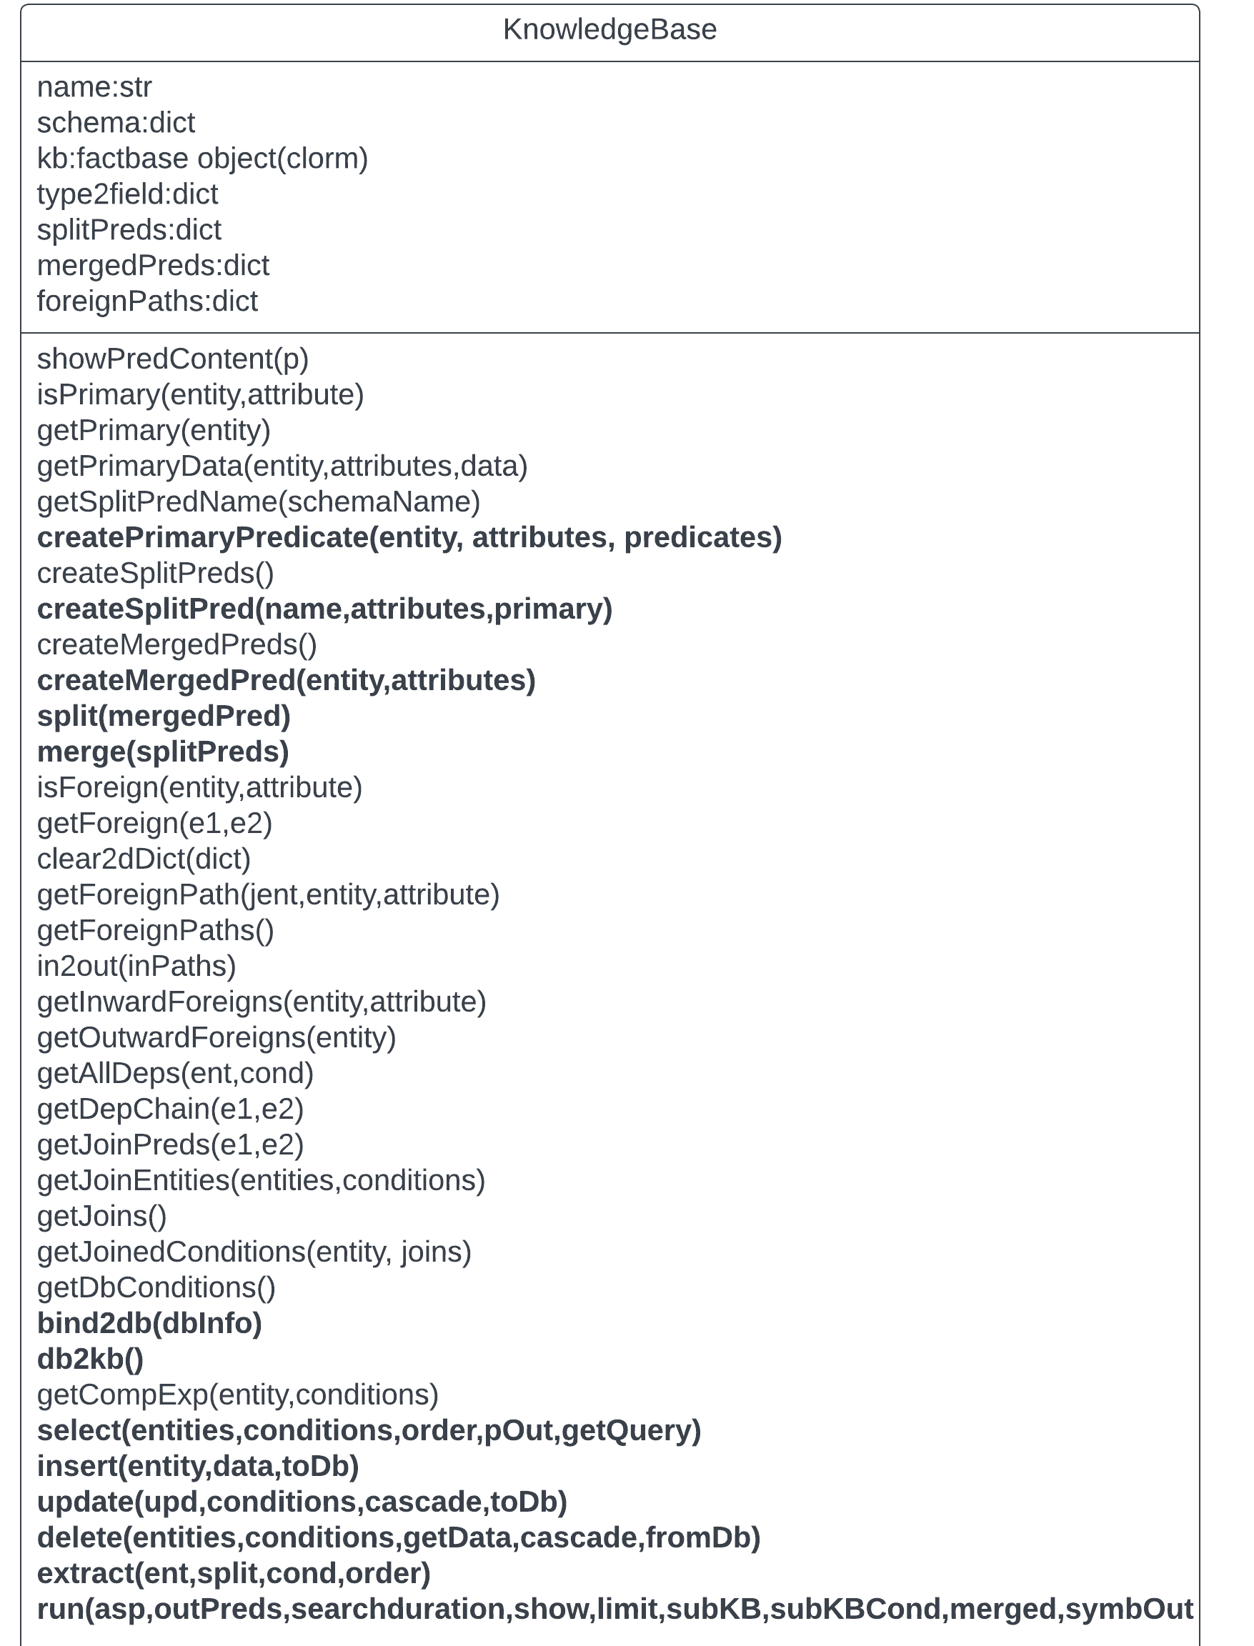
Python and clingo
clorm
clingo

Slide 25
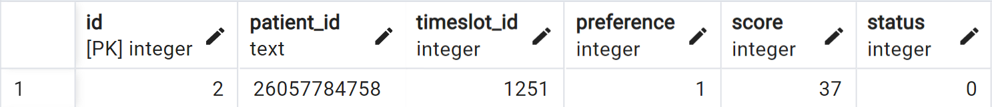
From record to predicate
Two types of encoding were tested for the purpose of translating an SQL record to an ASP predicate
1
2
Split
Merged
request(2) patient_id(2,26057784758) timeslot_id(2,1251) preference(2,1) score(2,37) status(2,0)
Used for solving
Used for KBMS
request(2,26057784758,1251,1,37)
+
Smaller KB
Much easier to use with SQL type transactions in the KB
-
Less readable code
Can cause a slight drop in performance due to more complex rule expression and the many anonymous variables
+
Code resembles natural language
Easier to express more complex rules
-
More predicates in KB
Much higher complexity of SQL
type transactions in the KB

Slide 26
03
The AI solution
Solving the problem with PostgreSQL, Python and ASP

Slide 27
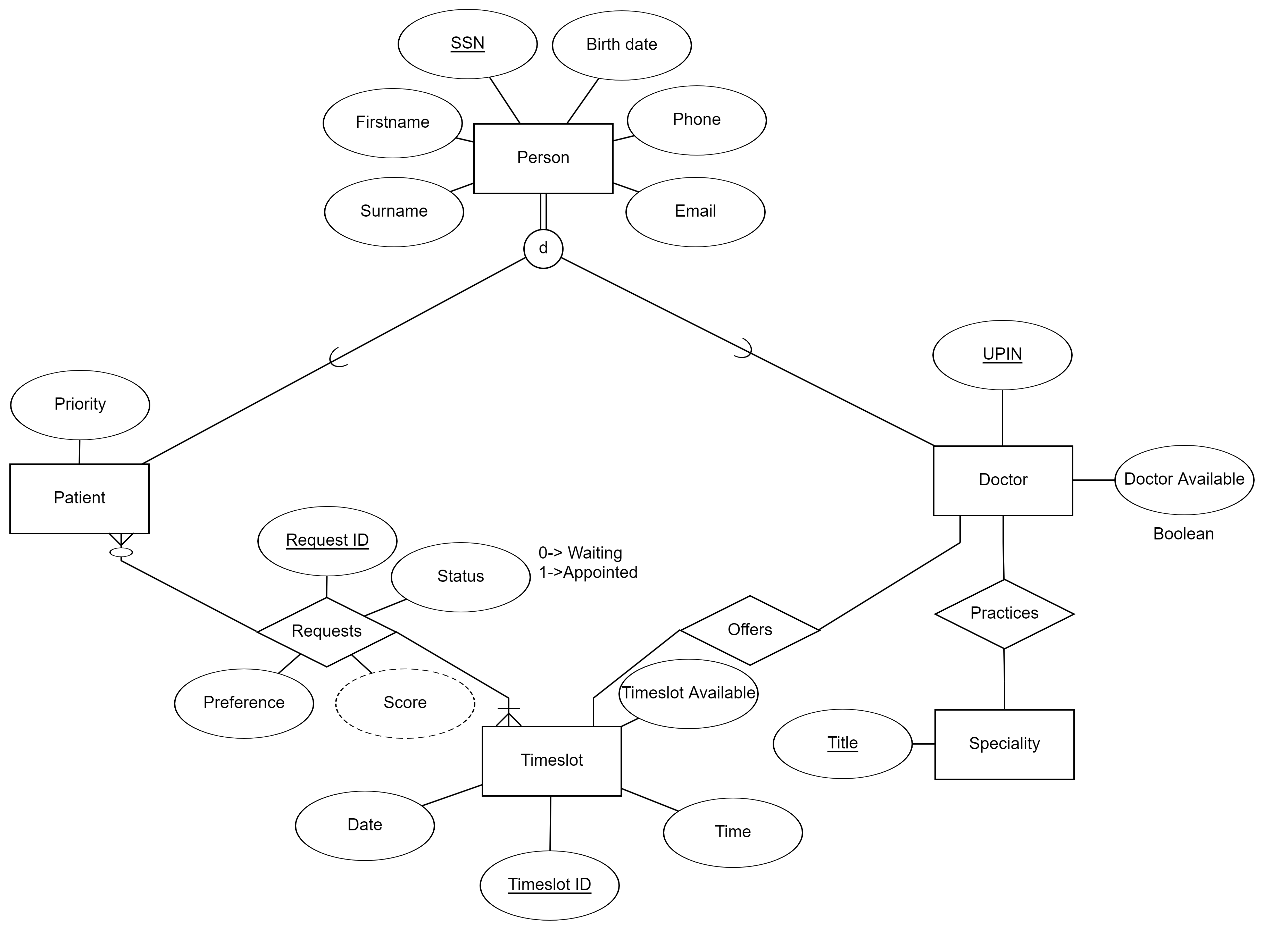
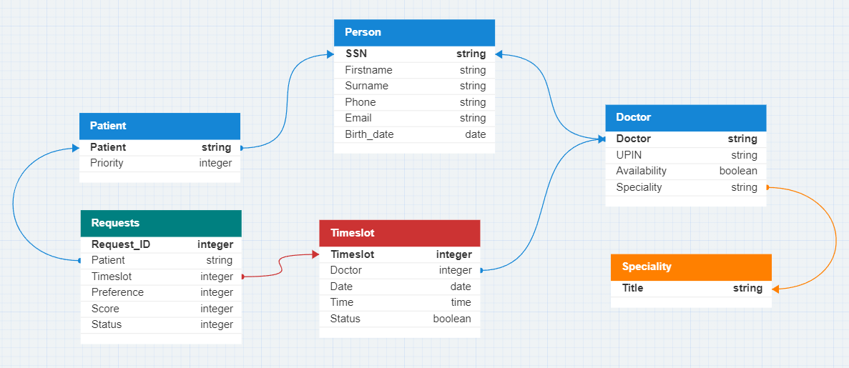
Database design
PostgreSQL, ideal for modern web applications
Entity Relation Diagram (ERD)
Database schema

Slide 28

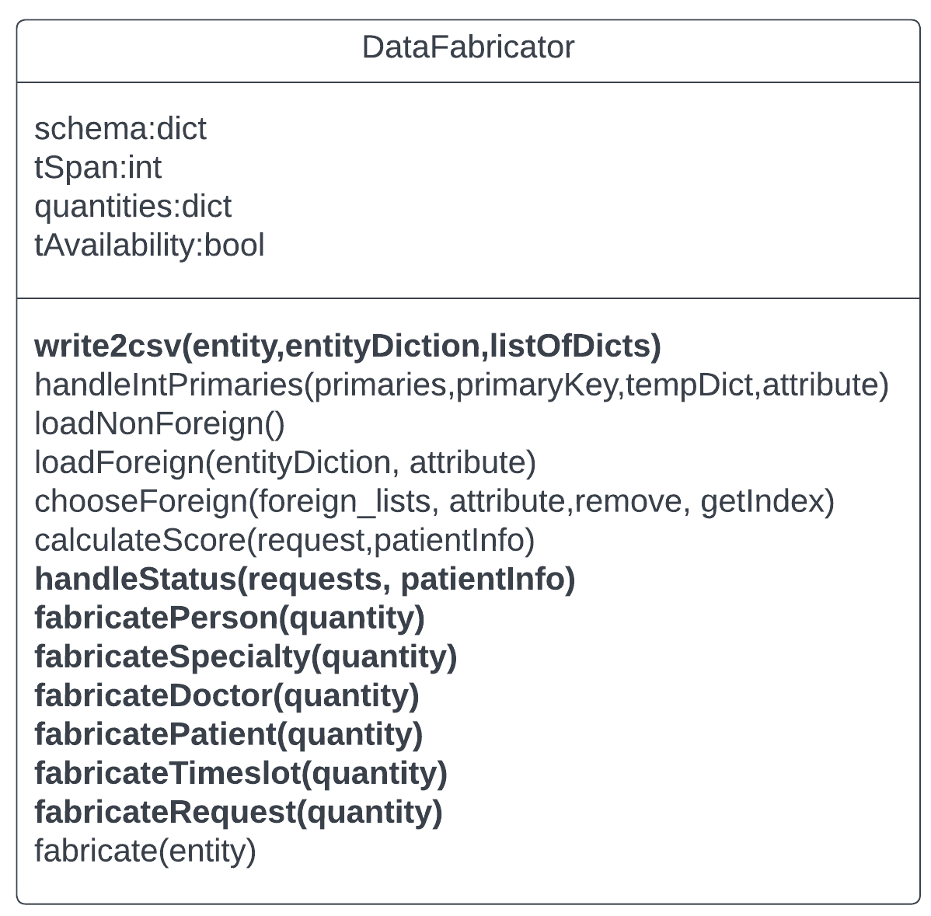
Data fabrication
The DataFabricator class was developed for testing purposes
Dynamically create pseudo realistic healthcare systems
Assumes 2 appointments per patient
Assumes an 9 to 5, five days a week schedule for doctors
Schedules the appointments by choosing the highest (best case) or the lowest (worst case) score

Slide 29
Solution axioms

Slide 30
The clingo code
Output
predicates
Output and auxiliary predicates
Grant
Claimed
Appointed
The appointment will be granted in the next schedule.
Represents the effect axiom
The appointment is granted and is the first choice of a patient. Represents the frame axiom.
The patient has booked
an appointment
Granted
OnlyOption
SingleRequest
The appointment is currently
appointed to a patient.
The appointment is a patient’s
only option
This request is the only one for a specific appointment
Best
BestSingleRequest
The appointment is the first
choice of a patient
This is the highest scoring of the
patient’s single requests

Slide 31
The clingo code
Set generation rules
01
0 {grant(R)} 1 :- granted(R), not best(R)
Include the granted but not best requests as a patient can retain their currently owned appointment if it appears in the answer set that maximizes the common benefit.
02
0 {grant(R)} 1 :- patient_id(R, P), score(R, S), not granted(R), patient_id(X,P), score(X, SX), granted(X), S > SX, R != X.
Include the not granted requests of a patient already having a granted request, that present a higher score than the one currently appointed to the patient. This enables a patient to receive a request with higher priority if it helps to maximize the common benefit.
03
0 {grant(R)} 1 :- patient_id(R, P), not appointed(P).
Include all the requests that belong to a patient who has not been appointed a timeslot if this leads to the optimal answer set.

Slide 32
The clingo code
Logic constraints
01
:- grant(R1), timeslot_id(R1, T), grant(R2), timeslot_id(R2, T), R1 != R2.
Each timeslot can be appointed to only one patient.
02
:- grant(R1), patient_id(R1, P), timeslot_id(R1, T1), doctor_id(T1, D1), specialty_title(D1, S), grant(R2), patient_id(R2, P), timeslot_id(R2, T2), doctor_id(T2,D2), specialty_title(D2, S), R1 != R2.
Each patient can only receive one timeslot (from a specific specialty if the general scope is used).

Slide 33
The clingo code
Fairness constraints
01
:- granted(R), patient_id(R, P), not claimed(R), 0 { grant(X) : patient_id(X, P) } 0.
If a patient had an appointment in the previous schedule a timeslot must also be granted to that patient after the rescheduling.
02
:- timeslot_id(R, T), patient_id(R, P), score(R,S), grant(R), not granted(R), appointed(P), timeslot_id(X, T), score(X, SX), onlyOption(X), S < SX, R != X.
If a request is a patient’s only option, it cannot be dismissed for the sake of a lower scoring request even if it leads to a chain reaction that maximizes common benefit. If we don’t apply this constraint a patient with only one request will most probably never receive an appointment.

Slide 34
The clingo code
Set exclusion to increase performance
01
:- grant(R), timeslot_id(R,T), claimed(X), timeslot_id(X,T), R != X.
All requests that claim an already claimed timeslot will not be taken into consideration.
02
:- timeslot_id(R, T), patient_id(R, P), score(R,S), grant(R), not granted(R), appointed(P), timeslot_id(X, T), score(X, SX), onlyOption(X), S < SX, R != X.
All the single requests that are not the patient’s best single request will not be taken into consideration.

Slide 35
The clingo code
Automatic assignments to increase the number of served patients
01
:- patient_id(R, P), score(R, S), bestSingleRequest(R), patient_id(X, P), score(X, SX), granted(X), R != X, S > SX, patient_id(Y, P), Y != R, grant(Y), not grant(R).
If a request is a patient’s best single request and it has a better score than the one already granted to the patient it will automatically be assigned to the patient blocking all the other requests made by the patient.
02
:- patient_id(R, P), bestSingleRequest(R), not appointed(P), patient_id(Y, P), Y != R, grant(Y), not grant(R).
If a single request is attributed to an unappointed patient, the system should grant it automatically and block all the other requests made by the patient.

Slide 36
Evaluation
Parameters that affect the performance
The previous state of the canceled appointment (granted or not granted)
The type of prior scheduling (close or far from optimality)
The total number of timeslots
The patients to request and the request to timeslot ratio (demand)
The path followed to reach optimality
The difference in the number of predicates in the KB caused by the choice of encoding

Slide 37
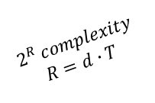
Evaluation
$$2^{R }complexity$$
$$R=d∙T$$
Execution times for 3 different datasets
Timeslots | Patients | Requests | Execution Time (s)
 |  |  | Best | Worst
400 | 500 | 1000 | 0.06 | 2.79
960 | 1200 | 2400 | 0.18 | 152.07
2000 | 2500 | 5000 | 421.4 | >1800
Timeslots | Patients | Requests | Execution Time (s)
 |  |  | Best | Worst
400 | 500 | 1000 | 0.09 | 4.19
960 | 1200 | 2400 | 0.15 | 448.9
2000 | 2500 | 5000 | 516.9 | > 1800
Split encoding
Merged encoding

Slide 38
04
From concept to reality
Facing the challenges of a real-world implementation

Slide 39
Performance limitations
Although very powerful, ASP solvers have their limitations. Possible paths to further scalability are:
Further code
optimization
Set time limit
Limit models
More constraints can
be added and
less set can be
created with further
code optimization
Sacrificing optimality an interrupt signal can be given
to the solver if a model occurs
after a certain time limit
Again, at the cost
of optimality a limit for the number of examined models can be set
Batching
The most practical path to scalability is to search for a more localized optimality through batching according to a specific unit. The lowest level of clustering will always be the fundamental resource, in this case the doctors and their time. The total optimality will be sacrificed but the level of specialization can be tuned to get a high enough benefit for a low enough execution time

Slide 40
Applying batching for 2000 timeslots
 | Time(s) | Benefit
General | 315,64 | 8161
Specialty | 3,51 | 7339
Doctor | 1,73 | 5831

Slide 41
Web App UI
1
2
Log in
Display the current schedule
3
4
Store the requests and their score in the database
Actively listen for a cancelation

Slide 42
In the event of a cancelation
1
2
Delete the request from DB
Inform the KB
3
4
Run the rescheduler
Contact the patiens of the action chain

Slide 43
Managing action chains
The explainability of ASP provides us with an action chain of request to grant at the end of the optimization process. To realize the chain, patients should give their consent. The process will use only automated contact methods with binary (yes/no) answers.
The chain
breaks
The system finds
the patient behind
the first request of
the solver’s output
An automated
text is sent asking
for permission to
reschedule the patient to
a better request
The
process
continues

Slide 44
Managing action chains
What if in the meantime another cancelation happens?
01
02
03
Immediately break the
chain sacrificing part of
the previous
rescheduling
Wait for the
confirmation process
of the previous chain to
finish
Set a timeout for the
patient’s response and
reschedule after it expires for
the first time breaking the
previous action chain
Take into consideration only
the confirmed part of the
previous chain. Update the
database and then
reschedule with
the new cancelation.
Wait for the previous
rescheduling to be fully
realized before the new
rescheduling starts.
A happy medium between
solutions 1 and 2, the
previous action chain will be
taken into consideration only
If its confirmation
process progresses
at a reasonable rate

Slide 45
Robustness

Slide 46
Thanks!
Do you have any questions?
stavroskanias@gmail.com - up1066563@upnet.gr
https://github.com/StavrosKanias/Medical_Appointment_Rescheduling_App
+30 694 755 3976
Please keep this slide for attribution

Slide 47
Resources
Bibliography
M. Hawkins, "Survey of Physician Appointment Wait Times and Medicare and Medicaid Acceptance Rates," AMN Healthcare, 2022.
A. H. Gertz, C. C.Pollack, M. D.Schultheiss and J. S. Brownstein, "Delayed medical care and underlying health in the United States during the COVID-19 pandemic: A cross-sectional study," Preventive Medicine Reports, 2022.
S. Kanias, "An AI approach to Large Scale Medical Appointment (Re)Scheduling Using ASP," University of Patras, Patra, 2023.
Icons
Icon Pack: Medicine | Lineal
Online
J. Gier, "Healthcare Innovation," SCI Solutions, [Online]. Available: https://www.hcinnovationgroup.com/clinical-it/article/13008175/missed-appointments-cost-the-us-healthcare-system-150b-each-year. [Accessed August 2023].

Slide 48


